Slide 1

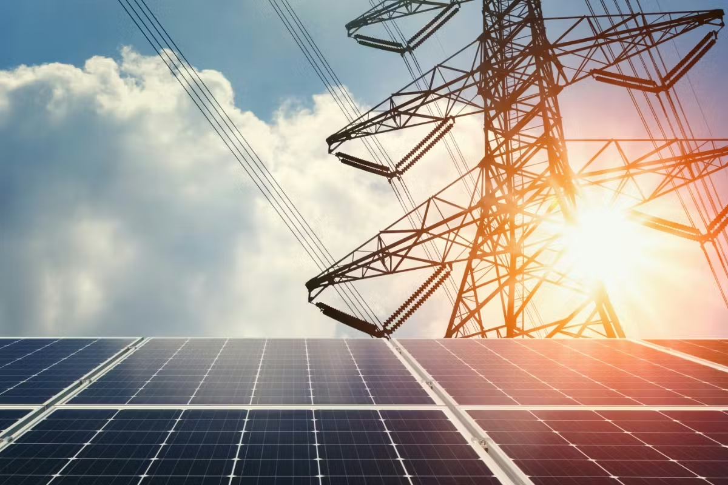



Session 5.2: Off-Site Solutions Deep Dive
Vietnam’s DPPA
Pricing Considerations

Slide 2

About the Speaker
Cong Nguyen
Allotrope Partners
Vietnam Clean Energy Manager
Cong is a renewable energy professional with over a decade of experience. Prior to joining Allotrope, Cong cultivated extensive clean energy technical expertise by supporting the development of solar and wind farms, battery energy storage systems, and asset management projects. In his role with Allotrope, Cong supports corporate clients to evaluate and implement clean energy and decarbonization solutions across a range of technologies. This includes leading techno-economic assessments to determine costs and benefits for specific sites, managing projects and building stakeholder relationships, and supporting business development efforts in Vietnam. Cong holds a Bachelor’s degree in Electromechanics Maintenance Engineering from Hung Yen University of Technology and Education and has advanced certifications in renewable energy and reliability engineering.

Slide 3
Session Roadmap • Module 5 walks the three canonical cases (matched / shortfall / excess) — same five-line math the app uses.
Follow the Money: From your EVN Bill to a Bankable DPPA
# | Module
1 | The Baseline: What You Pay EVN Today
2 | Virtual DPPA Money Flow: The Five-Line Bill
3 | CfD Mechanics: What Drives Your Quoted Price
4 | Developer Economics and the Three Gates
5 | Case Studies 5 & 6
6 | Key Decision Points and Wrap-up
By the end of this session you will be able:
1. Breakdown a virtual DPPA monthly settlement into its five components and compare it to your EVN bill
2. Explain how the CfD strike, market price (FMP), loss factors, and grid fees set your net cost
3. See why buyers, sellers and lenders each have a “gate” and why a deal must pass all three
4. Leave with realistic pricing expectations grounded in a real factory model
Scope: Virtual DPPA (grid CfD) only.

Slide 4
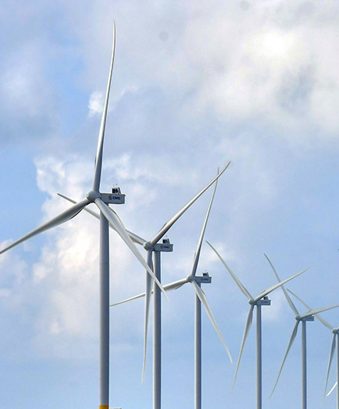
Module 1:
The Baseline: What You Pay EVN Today

Slide 5
Module 1 - The Baseline
What You Pay EVN Today: TOU Is The Reference Price
Period | Hours | Versus Base
Off-peak | 00:00 - 06:00 | ~0.52x
Normal | 06:00 - 18:00 | 1.0x
Peak | 18:00 - 23:00 | ~1.78x
Why this matters for DPPA
Every DPPA offer is judged against this bill: “business-as-usual” (BAU)
Peak hours cost 3.4x off-peak: your load shape decides what "average" means for you
Residual energy (load not covered by the DPPA) keeps paying these TOU rates
Sunday rule: no peak period on Sundays (all hours normal).
Voltage | Off-peak | Normal | Peak
>=110kV | 0.034 | 0.065 | 0.116
22-110kV | 0.037 | 0.070 | 0.126
6-22kV | 0.042 | 0.079 | 0.141
<6kV | 0.049 | 0.092 | 0.164
The savings benchmark
BAU = your current EVN bill escalated ~4%/yr (historical trend 2015-2024)
A DPPA is evaluated on cumulative cost vs BAU over 10 years and over the project lifetime - not just Year 1
EVN tariff escalation is the main source of long-term DPPA value
(USD/kWh approx. 2025)

Slide 6
Module 2:
Virtual DPPA Money Flow: The Five-Line Bill

Slide 7
Module 2 - The Five-Line Bill
Virtual DPPA Money Flow: Three Relationships, One Bill
VWEM SPOT MARKET
pays generator FMP
per kWh generated
energy -> market (FMP)
RE GENERATOR
sells 100% of output
to the spot market
YOUR FACTORY
pays EVN the DPPA bill;
settles CfD with generator
CfD settlement (two-way)
EVN
meters, wheels, & bills
the DPPA customer
DPPA bill (5 lines)
Physical electrons flow through the national grid as usual and the DPPA is a financial overlay
The generator's revenue = spot sales at FMP + CfD settlement with your factory
Your factory cost = the five-line EVN bill + the CfD settlement

Slide 8
Module 2 - The Five-Line Bill
Virtual DPPA Money Flow: Three Relationships, One Bill
VWEM SPOT MARKET
pays generator FMP
per kWh generated
energy -> market (FMP)
RE GENERATOR
sells 100% of output
to the spot market
YOUR FACTORY
pays EVN the DPPA bill;
settles CfD with generator
Pays FMP per kWh
CfD settlement (two-way)
EVN
meters, wheels, & bills
the DPPA customer
DPPA bill (5 lines)
Electricity Flows
Electricity Flows
Physical electrons flow through the national grid as usual and the DPPA is a financial overlay
The generator's revenue = spot sales at FMP + CfD settlement with your factory
Your factory cost = the five-line EVN bill + the CfD settlement
CFD
Electricity Flows
Financial Flows

Slide 9
Module 2 - The Five-Line Bill
The Monthly DPPA Settlement Has Five Lines
# | Line | Formula | Level (2025 reference)
1 | Market energy | Q_Khc x FMP x k x K_pp | FMP avg ~1,426.6 VND/kWh; k~1.026; K_pp by voltage
2 | DPPA service fee | Q_Khc x C_dppa_dv | 360 VND/kWh
3 | Balancing fee | Q_Khc x P_cl | 163.3 VND/kWh
4 | Residual purchase | (Load - Q_Khc) x EVN retail | TOU rates
5 | CfD settlement | (Strike - FMP) x min(Q_c, Q_Khc) | Two-way: can be + or -
Lines 1-4 are billed by EVN. Line 5 settles bilaterally with the generator under CfD contract.
Q_Khc = the renewable volume actually received and consumed (defined next slide).
CFMP = FMP x k: k converts the market price to the customer delivery point (price conversion, not a volume loss).

Slide 10
Module 2 - The Five-Line Bill
Contracted Volumes & Actual Electricity Consumption
Which volume? You settle only on what you actually consume
Q_adj = Q_meter / K_pp delivered volume at your meter
Q_Khc = min(Load, Q_adj) settled volume (lines 1-3)
Q_CfD = min(Q_c, Q_Khc) CfD settles on received volume
Grid losses are reflected through coordinated volume and price conversions: K_pp converts generator-meter output into buyer-side credited volume, while k and K_pp convert FMP into the corresponding buyer-side market-energy price.
If the plant generates more than you consume in an hour, the excess earns the generator spot revenue only; it is NOT billed to you and does NOT earn CfD
Practical consequence: Contracted volume (Q_c) above your real consumption buys nothing

Slide 11
Module 2 - The Five-Line Bill
Simulation: Industrial Park Buys 6,000 MWh/month
Parameter | Symbol | Value
Consumption = received RE volume | Q_KH = Q_Khc | 6,000,000 kWh/mo
Contracted CfD volume | Q_c | 6,000,000 kWh/mo
CfD strike price | P_c | 1,300 VND/kWh
Market price (monthly avg) | FMP | 1,200 VND/kWh
Price conversion factor | k | 1.026
Loss factor (110 kV) | K_pp | 1.008
DPPA service fee | C_dppa_dv | 360 VND/kWh
Balancing fee | P_cl | 163.3 VND/kWh
Avg retail price (residual) | P1 | 2,204 VND/kWh
Scenario
A 50 MW solar plant contracts its full output to one industrial customer
Consumption exactly equals delivered RE volume - no residual EVN purchase this month
Strike just 100 VND above market - watch what the fees do
Source: EAVCED public training

Slide 12
Module 2 - The Five-Line Bill
The Five Lines, Computed
Line | Calculation | VND/month
1. Market energy (C_DN) | 6,000,000 x 1,200 x 1.026 x 1.008 | 7,446,297,600
2. Service fee (C_dppa) | 6,000,000 x 360 | 2,160,000,000
3. Balancing fee (C_cl) | 6,000,000 x 163.3 | 979,800,000
4. Residual (C_bl) | 0 kWh x 2,204 | 0
EVN bill (C_EVN) | lines 1 + 2 + 3 + 4 | 10,586,097,600
5. CfD settlement (C_CfD) | (1,300 - 1,200) x 6,000,000 | 600,000,000
TOTAL (C_KH) | C_EVN + C_CfD | 11,186,097,600
Effective cost = 11,186,097,600 / 6,000,000 = ~1,864 VND/kWh for fully renewable supply (versus ~2,204 VND avg retail in the example)
Generator side: 6,048,000 kWh x 1,200 (spot) + 600,000,000 (CfD) = 7,857,600,000 VND

Slide 13
Module 2 - The Five-Line Bill
Your Monthly Settlement Has Five Lines
Component (per matched kWh) | VND/kWh | USD/kWh (cents)
Market energy at 2025 avg FMP x k x K_pp (22-110kV) | ~1,504 | ~6.0
DPPA service fee (C_dppa_dv) | 360 | 1.4
Balancing fee (P_cl) | 163.3 | 0.7
Delivered cost before CfD | ~2,027 | ~8.1
The 523 VND/kWh of fixed fees applies to every matched kWh, regardless of your strike
They are set by regulation, not negotiation
Compare ~2,027 VND delivered (pre-CfD) with your own TOU mix - for many factories that is already near or above average grid cost
Virtual DPPA is rarely a Day-1 discount. Its value comes from price certainty versus EVN escalation, being able to cover 100% of annual electricity demand with contracted renewable generation, and utilizing credible renewable claims.

Slide 14
Module 3:
CfD Mechanics: What Drives Your Quoted Price

Slide 15
Module 3 - CfD Mechanics
The CfD Is Two-Way: Certainty, Not Automatic Savings
CfD cash flow = (Strike - FMP) x Q_CfD
Net effect: the renewable energy cost is locked near the strike (+ fees), whatever the market does
2025 reference: FMP averaged ~1,427 VND/kWh with strong hourly volatility; the CfD removes that volatility from the budget
A strike below expected average FMP would mean expected receipts, but no developer can finance that (Module 4)
Market condition | Who pays whom
FMP below strike | You top up the generator
FMP above strike | Generator pays you back

Slide 16
Module 3 - CfD Mechanics
Strike Escalation & The Year 1 Reality
Strike escalation (e.g., 4%/yr)
What Year 1 usually looks like
Escalating strikes improve the seller's and lender's lifetime economics...
...but do nothing for the Year 1 cost and compound against BUYER later
Negotiate the escalation index as hard as the starting strike (fixed VND vs CPI vs USD-linked)
In most realistic structures, Year 1 DPPA cost is at or above BAU
Savings build as EVN tariffs escalate (~4%/yr) against BUYER locked strike
→ Advice: Evaluate on 10-year and lifetime cumulative cost, not on Year 1 alone
Internal Budget Question to Consider: Can we accept a modest Year 1 premium to cap 15~25 year exposure?

Slide 17
Module 3 - CfD Mechanics
Contract Volume VS Your Load Shape
Solar generation peaks midday, but the factory runs its own shape. The overlap—hour by hour - is what matters most.
If you... | Then… | Cost consequence
Over-contract (Q_c > consumption) | CfD caps at consumed volume - excess earns nothing | You paid contract terms for volume you can’t settle
Match contract to hourly overlap | Every contracted kWh settles | Efficient; this is the target
Under-contract (Q_c < overlap) | More residual purchased from EVN at TOU | Less price certainty, smaller renewable claim
Ask every developer for an hourly (8760 hour) matching analysis against your meter data, not an annual percentage
Batteries can shift the overlap window but add CAPEX the tariff must carry (see the case study)

Slide 18
Module 4:
Developer Economics and the Three Gates

Slide 19
Module 4 - Developer Economics
Developer’s Perspective on Economics
Revenue =
Q_meter x FMP spot sales (volatile) +
(Strike - FMP) x Q_CfD
CfD with your factory (stabiliser)
The CfD converts volatile spot revenue into a near-fixed price on matched volume
Your strike IS the developer's bankable revenue line
Everything the lender checks flows from it
Capital Structure | 70% Debt / 30% Equity
Debt Term | ~10 years
Debt Interest Rate (VND) | ~8.5% per year
Debt Interest Rate (USD) | ~5% per year (International)
Equity Target Return | 12 - 15%+ IRR
CIT Incentives | 4 years exempt + 9 years at half rate

Slide 20
Module 4 - Developer Economics
A Deal Must Pass Three Gates to Proceed
THREE GATES
Gate | Who | Test | Strike pressure
1. Buyer | You | Cumulative cost <= BAU over 10 yr AND lifetime | Pushes strike DOWN
2. Seller | Developer | Equity IRR >= 12-15% | Pushes strike UP
3. Lender | Bank | Minimum DSCR >= ~1.20x every year | Pushes strike UP (hardest gate)
Cash available for Debt service
DSCR = , computed for every year of the loan
One CAPEX heavy year ( e.g., a battery replacement) can sink the whole financing even if averages look fine
The negotiation window is the strike range where all three gates “pass”; but it can be empty (see case study)
Debt Service
A strike below the developer's bankability floor does not mean a cheap deal;
it means no project.

Slide 21
Module 4 - Developer Economics
Key Lifecycle Items The Tariff Must Contain
Item | Typical assumption | Buyer Implication
PV degradation | ~0.5%/yr output decline | Matched volume shrinks; lost kWh repurchased from EVN at TOU
Battery replacement | Large capex every 8-10 years | Can highly impact DSCR in that replacement year
CIT holiday | 4 yr exempt + 9 yr half rate (RE projects) | Improves developer economics
FX exposure | VND strike vs USD capex/debt | USD-linked terms shift FX the risks; price it consciously
The above terms are key components of the tariff and are included even when they are absent from the term sheet
These rarely appear in headline term sheets, but each one moves the bankable strike floor and therefore your price.

Slide 22
Module 5: Three Canonical Cases

Slide 23
CANONICAL CASE A · MATCHED (Load = Gen)
5-line EVN bill + CfD settlement when factory consumption exactly matches contracted solar
MATCHED (=)
Factory: 4,200 kWh/h constant load × 24 h = 100,800 kWh/day. Solar: 4,200 kWh/h peak output × 24 h = 100,800 kWh/day. Every kWh of factory load is matched by a kWh of contracted solar.
EVN bill (5-line, on matched volume)
CfD settlement (factory ↔ developer)
1. Market energy: 100,800 kWh x 1,427 VND/kWh x 1.0342 = 148,760,983 VND
2. System service + DPPA fees: 100,800 kWh x 523.3 VND/kWh = 52,748,640 VND
3. Balancing fee: bundled in line 2
4. Shortfall retail purchase: 0 kWh (no shortfall) = 0 VND
Total EVN: 201,509,623 VND
5. CfD = (Strike - FMP) x Q_cfD
= (2,000 - 1,427) x 100,800 kWh
= +57,758,400 VND (factory pays developer)
FMP < Strike => CfD is a net cost to the factory at this strike level.
Net = EVN + CfD = 201,509,623 + 57,758,400 = 259,268,023 VND (2,572.10 VND/kWh)
Formula breakdown
EVN = FMP x Kpp x matched + FEES x matched = 1,427 x 1.0342 x 100,800 + 523.3 x 100,800 = 201,509,623 VND
CfD = (Strike - FMP) x matched = (2,000 - 1,427) x 100,800 = 57,758,400 VND (positive => factory pays developer)
Net = 259,268,023 VND vs BAU = 222,170,256 VND => Year-1 premium = 37,097,767 VND (+16.7%). Savings build as EVN escalates ~4%/yr.
vs BAU retail-only: 222,170,256 VND (2,204 VND/kWh). DPPA net 259,268,023 VND (2,572 VND/kWh) -- a 16.7% Year-1 premium. The payoff is price certainty over the horizon; savings build as EVN tariffs escalate (~4%/yr).
FMP ~1,427 VND/kWh is illustrative (NSMO/ERAV not publicly published). Retail 2,204 / fees 523.3 / loss 1.0342 are 2025 verified; settlement modeled hourly (Circular 16/2025 = 30-min).

Slide 24
CANONICAL CASE B · SHORTFALL (Load > Gen)
5-line EVN bill + residual retail purchase + CfD when factory load exceeds contracted generation
SHORTFALL (>)
Factory: 6,100 kWh/h × 24 h = 146,400 kWh/day. Solar: 4,200 kWh/h × 24 h = 100,800 kWh/day. Shortfall: 1,900 kWh/h × 24 h = 45,600 kWh/day — bought at retail.
EVN bill (5-line, on matched volume)
CfD settlement (factory ↔ developer)
1. Market energy: 100,800 kWh × 1,427 × 1.0342 = 148,760,983 VND
2. System service + DPPA fees: 100,800 kWh × 523.3 = 52,748,640 VND
3. Difference / balancing fee: bundled in line 2
4. Shortfall retail purchase: 45,600 kWh × 2,204.07 = 100,505,592 VND
Total EVN: 302,015,215 VND
5. CfD = (Strike − FMP) × Q_cfD
= (2,000 − 1,427) × 100,800 kWh
= +57,758,400 VND (factory pays developer)
CfD settles only on matched kWh — shortfall is a separate retail line.
Two bills: DPPA + residual retail on the gap.
Net = EVN + CfD = 302,015,215 + 57,758,400 = 359,773,615 VND (2,457.47 VND/kWh blended)
Formula breakdown
EVN = (FMP x Kpp + FEES) x matched + RETAIL x shortfall = (1,427 x 1.0342 + 523.3) x 100,800 + 2,204 x 45,600 = 302,015,215 VND
CfD = (Strike - FMP) x matched = (2,000 - 1,427) x 100,800 = 57,758,400 VND
Net = 359,773,615 VND vs BAU = 322,675,848 VND => Year-1 premium = 37,097,767 VND (+11.5%); shortfall at retail (2,204) dilutes the matched-kWh premium.
vs BAU retail-only: 322,675,848 VND (2,204 VND/kWh blended). DPPA net 359,773,615 VND (2,457 VND/kWh blended) -- a 11.5% Year-1 premium. Blended rate is lower than Cases A/C because shortfall kWh buy at retail (2,204). Payoff is still price certainty; savings build as EVN escalates.
FMP ~1,427 VND/kWh is illustrative (NSMO/ERAV not publicly published). Retail 2,204 / fees 523.3 / loss 1.0342 are 2025 verified; settlement modeled hourly (Circular 16/2025 = 30-min).

Slide 25
CANONICAL CASE C · EXCESS (Load < Gen)
5-line EVN bill + CfD when contracted generation exceeds factory consumption; CfD caps at consumed volume
EXCESS (<)
Factory: 2,600 kWh/h × 24 h = 62,400 kWh/day. Solar: 4,700 kWh/h × 24 h = 112,800 kWh/day. Excess: 2,100 kWh/h × 24 h = 50,400 kWh/day — generator keeps the spot revenue, no CfD applies.
EVN bill (5-line, on matched volume)
CfD settlement (factory ↔ developer)
1. Market energy: 62,400 kWh × 1,427 × 1.0342 = 92,090,132 VND
2. System service + DPPA fees: 62,400 kWh × 523.3 = 32,653,920 VND
3. Difference / balancing fee: bundled in line 2
4. Shortfall retail purchase: 0 kWh (Load < Gen) = 0 VND
Total EVN: 124,744,052 VND
5. CfD = (Strike − FMP) × Q_cfD, capped at consumed volume
= (2,000 − 1,427) × 62,400 kWh
= +35,755,200 VND (factory pays developer on consumed only)
Excess 50,400 kWh/day → generator spot only, no CfD.
Generator's spot revenue on excess: ~71,920,800 VND (not your bill).
Net = EVN + CfD = 124,744,052 + 35,755,200 = 160,499,252 VND (2,572.10 VND/kWh)
Formula breakdown
EVN = (FMP x Kpp + FEES) x matched = (1,427 x 1.0342 + 523.3) x 62,400 = 124,744,052 VND
CfD = (Strike - FMP) x matched = (2,000 - 1,427) x 62,400 = 35,755,200 VND (capped at consumed volume)
Net = 160,499,252 VND vs BAU = 137,533,968 VND => Year-1 premium = 22,965,284 VND (+16.7%). Fees only on matched kWh; CfD capped at consumed volume.
vs BAU retail-only: 137,533,968 VND (2,204 VND/kWh). DPPA net 160,499,252 VND (2,572 VND/kWh) -- a 16.7% Year-1 premium. Excess generation earns developer spot only (no CfD); factory is not billed for it.
FMP ~1,427 VND/kWh is illustrative (NSMO/ERAV not publicly published). Retail 2,204 / fees 523.3 / loss 1.0342 are 2025 verified; settlement modeled hourly (Circular 16/2025 = 30-min).

Slide 26
CALLOUT · DEVELOPER FINANCING (THREE GATES)
The Cases 5 & 6 lessons in one slide: right-size the BESS, then the negotiation is the strike
QUANTIFIED TAKEAWAY
WHAT THE THREE GATES SAY
1. DSCR — debt service coverage
The buyer turning positive doesn't save the project if DSCR < 1.20x.
2. Project IRR — equity return
A strike below the developer's bankability floor doesn't make it cheap — it kills the project.
3. Lender covenant — financeability
Low single-digit lifetime savings at best. You're buying 10-25 yr price certainty.
0 of 56
scenarios passed all three gates at current market prices
56-scenario sensitivity
BESS LESSON (Cases 5 & 6)
• 12 strike prices: 1,200–2,200 VND/kWh
• 4 contract volumes: 70–100% of generation
• Three gates: DSCR, project IRR, lender covenant
• Result: buyer turns positive just as lender drops out
Oversized BESS: buyer pays ~9% MORE than BAU on every horizon.
~$1.2M battery replacement cost is not carried by the tariff.
Right-sized BESS: DSCR 1.50x, bankable.
Then, the entire negotiation is the strike price.
Levers that can balance the deal:
lower leverage, debt sculpting, USD-denominated strike.
FMP ~1,427 VND/kWh is illustrative (NSMO/ERAV not publicly published). Retail 2,204 / fees 523.3 / loss 1.0342 are 2025 verified; settlement modeled hourly (Circular 16/2025 = 30-min).

Slide 27
CALLOUT · MULTI-PARTY NETTING
A portfolio of DPPA contracts behaves as if each customer-developer pair settled independently
THE RULE
WHAT IT MEANS
Net CfD = Σ per-pair settlements
For each plant ↔ customer pair, settle the matched kWh at (Strike − FMP).
Add the per-pair settlements across the whole portfolio.
No new model is needed. The same five-line bill runs per pair, in parallel.
1. Two-plant portfolio
Net CfD = CfD(plant X) + CfD(plant Y)
2. One plant ↔ many customers
Net CfD = Σ CfD(plant ↔ customer_i)
3. Customer C with mixed supply
Net CfD = CfD(solar X) + CfD(wind Y)
WORKED ILLUSTRATION (matches the deck's original Scenarios 4 & 5)
Solar X (600,000 kWh, strike 1,500) → Customer C: CfD = (1,500 − 1,427) × 600,000 = +43.8M VND (factory pays)
Wind Y (300,000 kWh, strike 1,500) → Customer C: CfD = (1,500 − 1,427) × 300,000 = +21.9M VND (factory pays)
Net portfolio: 65.7M VND (matches the deck's original worked example: solar 60M + wind 30M ≈ 90M from a different strike)
FMP ~1,427 VND/kWh is illustrative (NSMO/ERAV not publicly published). Retail 2,204 / fees 523.3 / loss 1.0342 are 2025 verified; settlement modeled hourly (Circular 16/2025 = 30-min).

Slide 28
Module 6:
Key Decision Points and Wrap-up

Slide 29
Module 6 - Decision Points
Five Questions That Change The Term Sheet
# | Decision | What to check
1 | Strike level & escalation/indexation | Fixed VND vs escalating/deescalating vs USD linked; model these vs BAU
2 | Contract volume vs load shape | 8760 hourly matching vs meter data; CfD caps at consumed volume
3 | Tenor & termination | Developer wants 15-25 yr; match to your lease / order book; exit terms
4 | Voltage eligibility & K_pp | >=22kV only today; which K_pp applies decides your loss adjustment
5 | Risk allocation | FMP volatility, curtailment, negative CfD months, change-in-law
Items 1-4 are quantifiable before negotiation; run them against load data first.

Slide 30
Module 6 - Wrap-Up
Three Core Reminders
Know the five-line bill: 523 VND/kWh of fees and the loss factor are fixed; the strike price remains the big number open to negotiation. Evaluated the deal on 10-year and lifetime cost vs BAU - not on Year 1 Every deal must pass buyer, seller AND lender gates: If the window is empty, the fix is structural, not just price • Use the 3 canonical cases (matched / shortfall / excess) at https://dppa-case.web.app to swap the strike and FMP live.
Next: Panel discussion on risk allocation and the reality of bank financing for Grid DPPA

Slide 31

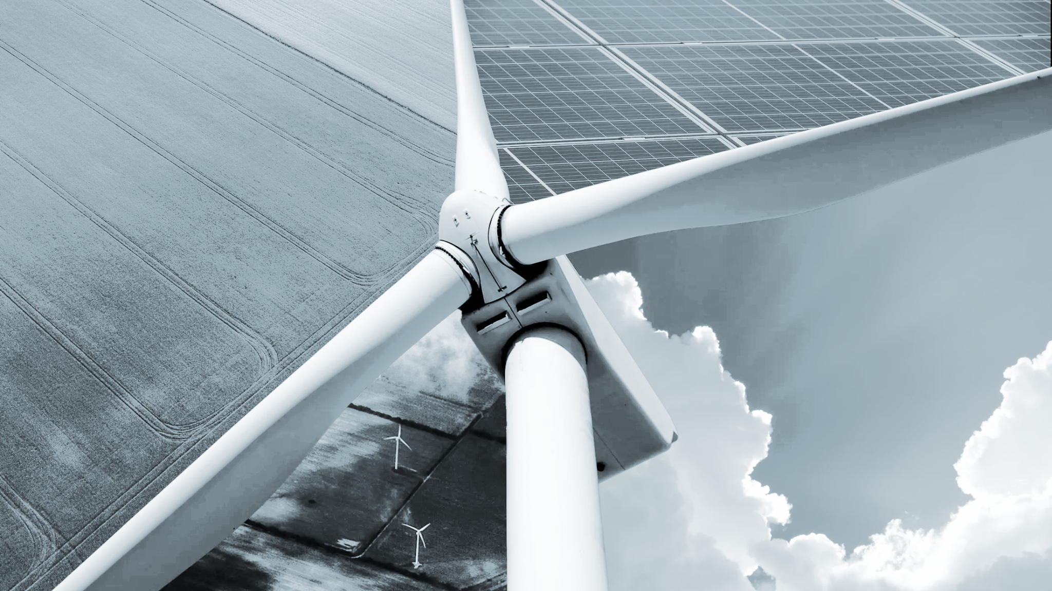


QR to be updated
Questions & Answers

Slide 32



Lunch time
Please come back by 13:15!
QR
To be finalized
Leave
questions
for us

Slide 33

Panel Discussion
Off-Site Solutions Deep-Dive: Unlocking DPPA
Tung Ho
(Moderator)
Vietnam Country Director
Allotrope Partners
Cong Nguyen
(Speaker)
Vietnam Clean Energy Manager
Allotrope Partners
Duc Nguyen
(Speaker)

Slide 34

Break
~20 minutes

Slide 35
Interactive Group Exercise
Roundtable Discussions on Procurement Lessons Sharing
(~45 minutes)
Please remain at your table.
Table facilitators will provide questions to discuss in an open dialogue format among the participants at your table.
Please share lessons from clean energy procurement processes that your company has conducted or challenges that have prevented clean energy action to date.

Slide 36
Interactive Exercise
Apply the 3 Canonical Cases (~60 minutes)
Please remain at your table.
Table facilitators will provide you with a resource packet containing case studies, description of roles, and key questions to facilitate the activity.
Collaborate with other participants to formulate a strategy, identify key terms and questions, and engage in a simulated DPPA negotiation.
Once the negotiation is complete, raise any remaining questions, or share challenges you experienced during the negotiation.

Slide 37
General Assumptions & Formula
Based on Decree 57/2025/ND-CP, the cost calculation parameters are assumed as follows: Legal basis: Circular 16/2025/TT-BCT (FMP = SMP + CAN, 30-min settlement); Decree 57/2025/ND-CP (grid CfD).
Symbol | Unit | Assumed Value | Description
k |  | 1,026 | Adjustment coefficient
CDPPA_dv | VND/kWh | 360 | Power system service cost
Pcl | VND/kWh | 163,3 | Differential clearing fee
Kpp |  | 1,008 | Loss conversion coefficient at 110 kV voltage level
P1 | VND/kWh | 2,204 | Average retail electricity price
Cost Formulas
C_KH = C_EVN + C_CfD
=
=
(Pc − FMP) * Qc
Qkhhc * FMP * k * Kpp = C_DN
Qkhhc * C_dppa_dv = C_dppa
Qkhhc * Pcl = C_cl
(QKH − Qkhhc) * P1 = C_bl
+
+
+
Note: The plant sells all output to the spot market (receives FMP); the CfD only adjusts the price to Pc for the contracted volume Qc.

Slide 38

Workshop Recap and Wrap Up

Slide 39
Key Takeaways Day 2
DPPA represents a critical step in scaling RE procurement in Vietnam. Large energy customers, customers lacking facility’s aligned with on-site requirements, and industrial park tenants can benefit from expanded access to RE procurement First DPPA transactions are emerging in Vietnam. Early transactions are demonstrating the process and economic feasibility of VPPAs in Vietnam Facility load profile is a key driver of cost performance. Day time load demand aligned with RE peak production can help to reduce costs under DPPA. Cost ranges are critical for feasibility analysis: Market volatility, grid-loss adjustments, and load matching all materially affect DPPA costs - assess costs based on a range of downside and upside cost scenarios. First grid DPPA live in 2026: Samsung SEVT (Thai Nguyen) ↔ TTC Duc Hue 2 (49 MWp solar + BESS, COD 19 May 2026), ~70 GWh/yr, ~46,000 tCO₂/yr avoided.

Slide 40
Recap and Wrap Up
Urgent need for action: Companies need to act quickly to implement clean energy solutions within this decade, as climate change is already significantly impacting Vietnam and the world.
Sustainability strengthens your business case: Emphasizing sustainability builds brand reputation, enhances client relationships, and increases positive public exposure. It also helps manage risks associated with energy management, regulatory compliance, and climate change.
Measuring emissions is critical: Understanding and quantifying GHG emissions across Scopes 1, 2, and 3 is crucial for effective sustainability management.
Regulatory requirements are emerging: In Vietnam, facilities with annual GHG emissions of 3,000 tons CO2 equivalent or more will be required to implement GHG emission reduction measures.
Data accuracy is key: Accurate data collection and reporting are essential for effective emissions tracking and reduction strategies.
Corporate demand for RE in Vietnam is growing: The C&I sector has the potential to send strong demand signals for accessible, expanded, cost-effective RE in Vietnam.
Challenges persist: While on-site clean energy procurement options are available today, off-site options are emerging, and scalability is limited by evolving policy, market, and technical challenges.
New opportunities are emerging: The introduction of the Direct Power Purchase Agreement mechanism may provide a significant opportunities for large energy buyers to advance off-site clean energy solutions, however, implementation is just beginning.

Slide 41
Recap and Wrap Up
01
Vietnam's DPPA is a game-changer
02
Pricing complexity is real
03
Load profile determines economics
The DPPA is now operational; implementation complexity demands careful planning and local expertise Key negotiation variables: electricity retailer, RE source type, required capacity, contract duration, and project development status
Market volatility, grid-loss adjustments, and load matching all materially affect DPPA costs. Model the full formula — not just the strike price — before contracting.
Load timing significantly affects economics: operations with steady daytime demand see stronger DPPA outcomes than those with evening/night-heavy profiles
04
Corporate demand shapes the market
05
GHG measurement is the foundation
06
Act now — the window is open
C&I buyers collectively drive demand signals that influence RE accessibility, pricing trajectories, and supportive policy — early movers carry outsized influence.
Credible Scope 1, 2, and 3 measurement is a prerequisite for effective decarbonization action and meeting Vietnam's emerging regulatory requirements.
Regulatory requirements are tightening and market structures are maturing. Companies that engage early will gain first-mover advantage as DPPA scales.

Slide 42
Key Takeaways
Corporate demand for RE in Vietnam is growing: The C&I sector has the potential to send strong demand signals for accessible, expanded, cost-effective RE in Vietnam.
Start with your load and emissions data. Clean energy procurement decisions should begin with goal setting, facility-level electricity consumption, load profile, Scope 1–2 emissions, and any relevant Scope 3 or product carbon footprint requirements.
Match the solution to the facility constraint. On-site solar is the most available near-term option, but roof space, facility ownership, tenancy terms, and industrial park rules constraints will determine feasibility.
Treat BESS as a procurement design tool, not only a technology add-on. Battery storage can improve tariff resilience, increase daily renewable energy consumption, support peak shaving, and improve the commercial case for solar under evolving tariff structures.
Use RECs/EACs carefully and transparently. Unbundled RECs/EACs may support Scope 2 claims, but buyers should understand attribute ownership, additionality concerns, and the use cases between EACs and carbon offsets.
Monitor DPPA developments, but plan for uncertainty. DPPA may unlock larger off-site procurement, but buyers should account for evolving cost inputs, wheeling charges, settlement structures, and first-mover implementation challenges.
Challenges persist: While on-site clean energy procurement options are available today in Vietnam, scalability and further replication is limited by evolving policy, market, and technical challenges.

Slide 43
Key Takeaways - Day 1 Action Checklist
Confirm your clean energy objective and set actionable targets Identify your facility’s key decarbonization goals: Scope 2 reduction, buyer compliance, RE100 alignment, product carbon footprint reduction, or long-term price stability, and set actionable intermediate and long term targets to achieve these objectives.
Gather the right data Work with facility staff to collect 12 months of electricity bills, 30-minute or hourly load data if available, roof drawings, facility lease/ownership status, current EAC/REC contracts, and buyer sustainability requirements to assess site feasibility and constraints.
Screen near-term procurement options Assess rooftop solar+BESS where load, load shape, evening usage, or future tariff exposure align. Evaluate RECs/EACs as a complementary tool, not a substitute for direct procurement where feasible. Assess your site’s suitability for offsite procurements, and remain up to date on policy evolution.
Identify decision-makers and constraints Map who needs to approve the project: headquarters, procurement, finance, legal, factory management, landlord, industrial park operator, EVN/local utility, or sustainability/customer teams, and help decision makers understand the business case for RE procurement.

Slide 44
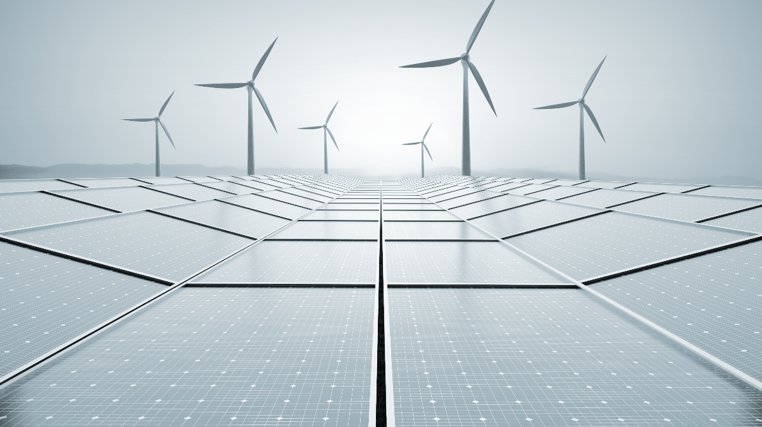

Before departing, please help fill out the Post-Event Survey.
Wrap Up & Survey (~5 minutes)
THANK YOU!
QR to be updated
Please contact us with any questions:
Tung Ho, tah@allotropepartners.com
info@allotropepartners.com

